Slide 1
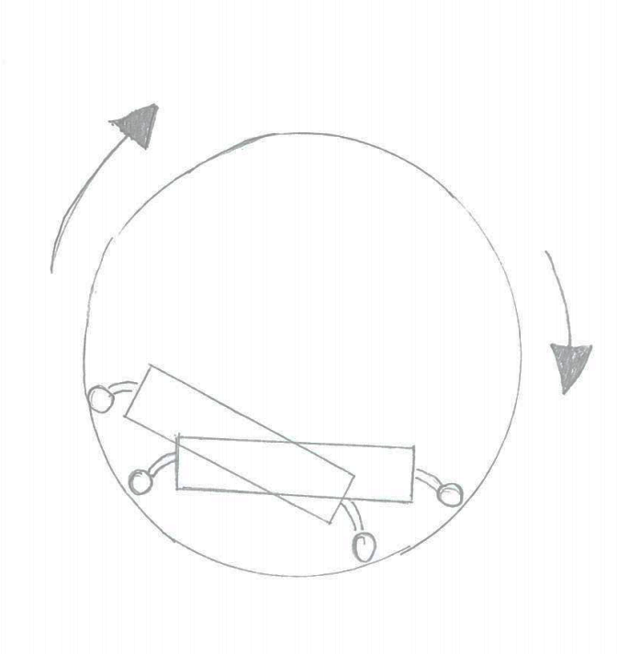
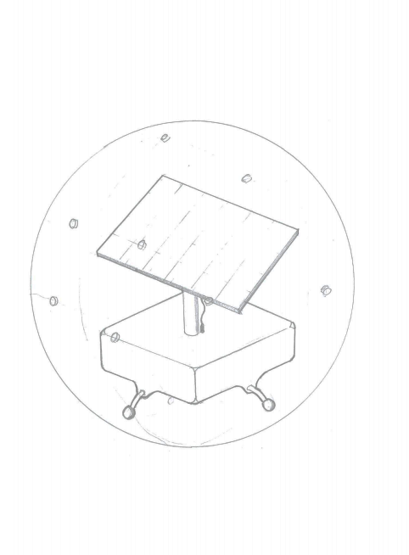
Transparent, 2 part perforated hemispheres
Solar Panel
Electronics enclosure
Universal transfer bearings

Slide 2
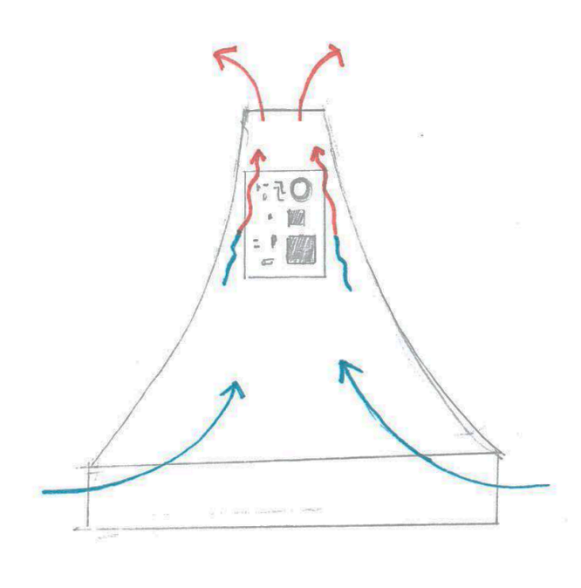
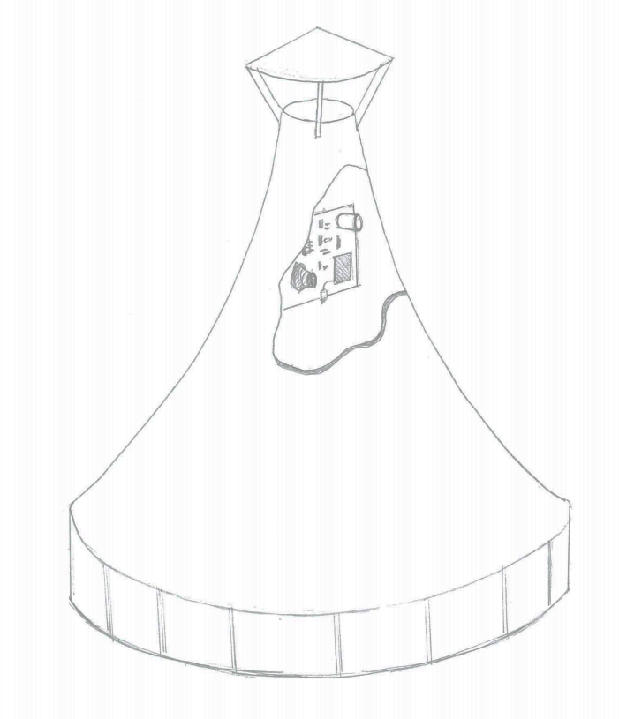
Rain cover, elevated to allow air flow
Electronics and sensors mounted vertically inside chimney
Open segments to allow air intake

Slide 3
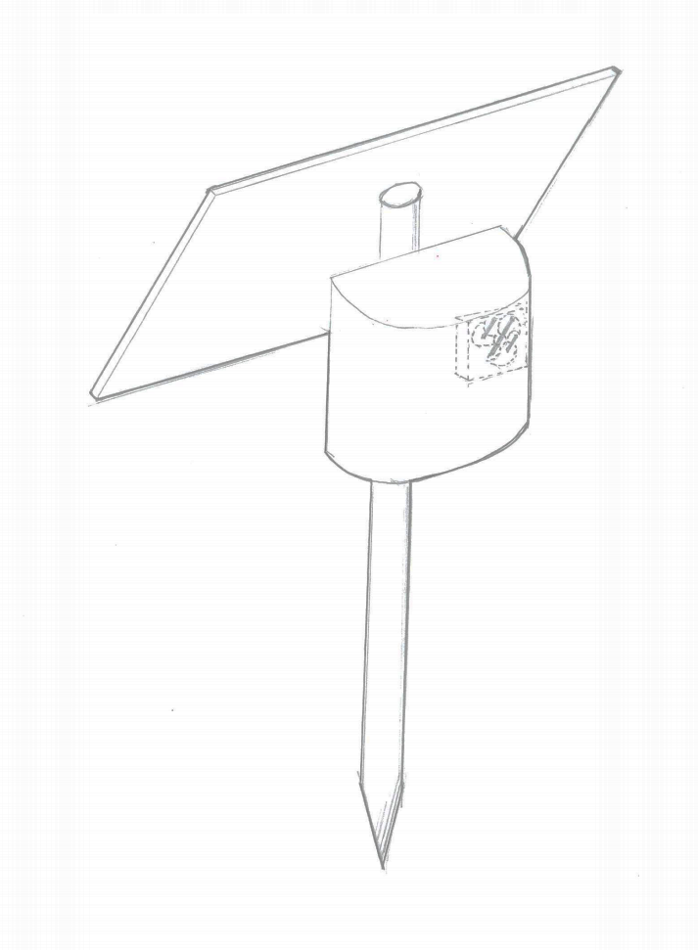
Solar Panel
Slits for allowing air flow
Electric fan
Electronics Enclosure
Universal transfer bearings

Slide 4
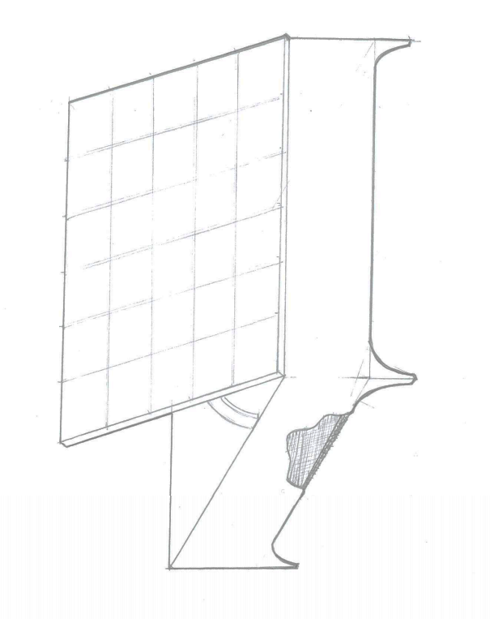
Solar Panel
Electronics and sensors mounted vertically inside chimney
Underside of sensor air permeable mesh

Slide 5
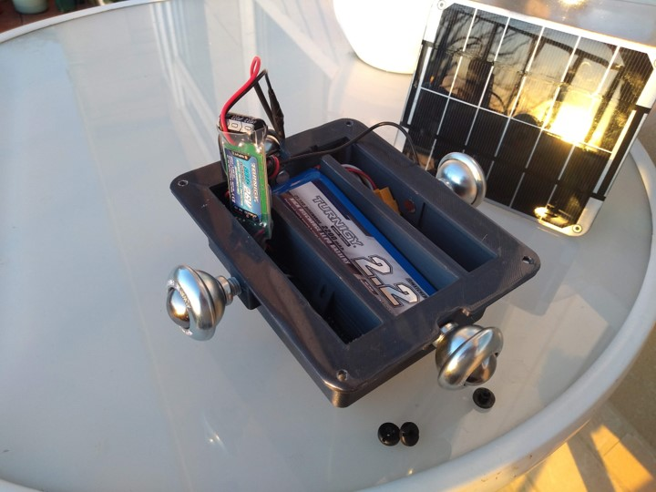
Turnigy 2200 mAH LI-PO Battery
Adafruit 6V Solar Panel
Turnigy 8-26V input 5V output SBEC
19mm Steel ball transfer unit

Slide 6
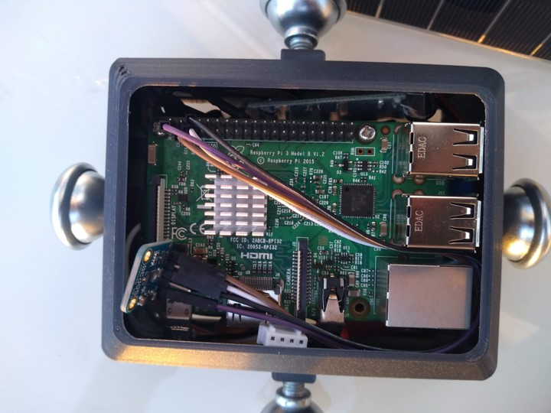
Raspberry Pi 3
GPIO pins
SGP30 TVOC/eC02 gas sensor
USB-C power cable

Slide 7
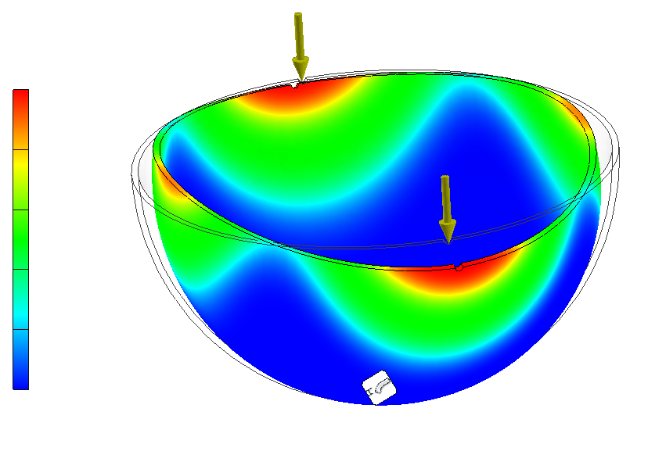
Displacement (mm)
0.436
0.0

